Slide 1

Detecting Phishing Websites through Reinforcement Learning and NLP
M.Tech Major Project
Presented by
Nikunj Rathod
202211014

Slide 2

Introduction
Phishing
Reinforcement Learning
Img src: https://www.fpsgold.com/blog/identify-and-stop-phishing-attacks

Slide 3
Phase I
Summer Project
Phishing Detection with Reinforcement Learning
Phase II
Major Project
Phishing Detection using RL with NLP

Slide 4
Literature Survey
A. Lakshmanarao, M. R. Babu and M. M. Bala Krishna, "Malicious URL Detection using NLP, Machine Learning and FLASK," 2021 International Conference on Innovative Computing, Intelligent Communication and Smart Electrical Systems (ICSES), Chennai, India, 2021, pp. 1-4, doi: 10.1109/ICSES52305.2021.9633889
M. Chatterjee and A. -S. Namin, "Detecting Phishing Websites through Deep Reinforcement Learning," 2019 IEEE 43rd Annual Computer Software and Applications Conference (COMPSAC), Milwaukee, WI, USA, 2019, pp. 227-232, doi: 10.1109/COMPSAC.2019.10211.
R. M. Mohammad, F. Thabtah and L. McCluskey, "An assessment of features related to phishing websites using an automated technique," 2012 International Conference for Internet Technology and Secured Transactions, London, UK, 2012, pp. 492-497.

Slide 5
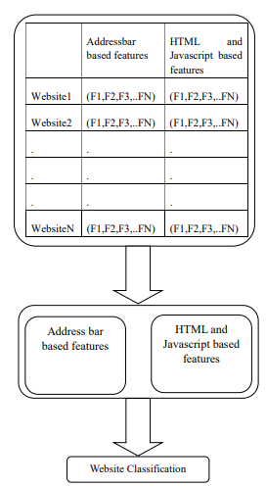
Existing Method
Addressbar based and HTML/JS based features with machine learning techniques and deep learning based techniques.
Deep Reinforcement Learning based method with same technique of feature extraction.

Slide 6
Proposed Method
Dataset: PhishTank Website
Preprocessing: Splitting by (‘/’)
Word2Vec Training: parameters (vector_size, window, min_count, sg)
Embeddings Generation: The trained Word2Vec model is used to generate embeddings for each word in the preprocessed URLs.
Deep Q Network : The agent uses a DQN model, implemented with TensorFlow/Keras, to approximate the Q-function.
Training:The training loop iterates through episodes, where each episode corresponds to a row in the training dataset.
Evaluation:The evaluation function calculates the accuracy by comparing predicted actions with true labels.

Slide 7
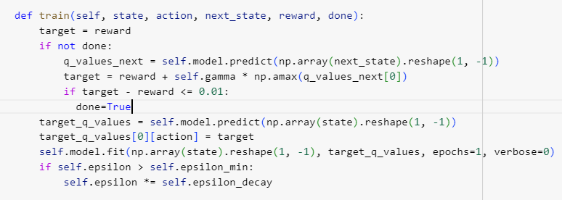
Training

Slide 8
Network Architecture and Parameters
Input Layer | 100
Hidden Layer | 128
Hidden Layer | 256
Hidden Layer | 128
Hidden Layer | 64
Output Layer | 2
Hyperparameters | Values
Learning rate | 0.001
gamma | 0.99
epsilon | 1
epsilon_decay | 0.995
epsilon min | 0.01

Slide 9
Comparative Analysis
Method | Accuracy
Proposed Method | 89%
"Detecting Phishing Websites through Deep Reinforcement Learning” | 90%
Malicious URL Detection using NLP, Machine Learning and FLASK | 87.5%
Github repository : Click Here

Slide 10
Conclusion
The method uses Word2Vec for feature extraction and Reinforcement Learning for training and testing purpose. The accuracy is quite lower than the traditional ML and DL techniques when compared to similar methodologies. But can be improved further.

